Slide 1
AI Robotics – ROS Introduction
Márk Domonkos
PhD Student

Slide 2

About me
MSc in Mechatronics from BME
currently: Phd Student at Dept. AI
Contact:
domonkos@inf.elte.hu
MS Teams
Research interests:
Robotics and HRI/HRC
AI
Embedded systems / mechatronics

Slide 3

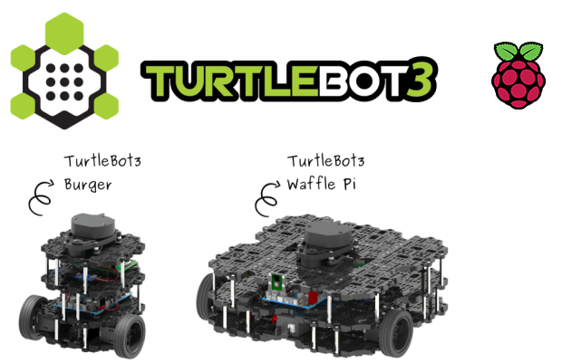
What will we learn during the practice?
ROS2 Foxy
How to use this environment
How to program a robot with this environment via its basic elements
Communication between parts of the robots or between robots etc.
Basics of modeling a robot, robot components and environments
Why Foxy? → We have robots that work with Foxy ;)
source
source

Slide 4
What will be the form of the practices?
We will have (except this first practice) self paced practices
Materials will be provided before the practice.
On practice individual work with the source materials.
Ask questions!!! (thats why we are here ☺) = ‚No such thing exists as stupid question when learning, but only people, who were not brave enought to ask the „stupid” question.’ – I don’t know the quote’s source, sorry ☺
During / After the practice You are encouraged to post/comment notes/questions in the MS Teams group’s Practice channel for further discussion. – It is completely Yours, I am only a moderator there.
You are welcome to ask me questions before/after the practice as well, via e-mail, MS Teams or in-person at the department.

Slide 5
What will be the requirements on the practice?
2 Assessment during the practice after each bigger topic
Programming tasks (open book policy)
During practice (90 min) codes needs to be finished
After the assessment, 2 days are given to send a one-pager „documentation” of the work given
Each assessment has 15% in the final grade
Completion (understanding) of the current material from week-to-week. (questions in the assessments will be asked from the material.)

Slide 6
Where to find the material?
It is awailable at:
https://gitlab.com/aidept_mitsz/ros-for-non-robot-specialists
You will need to log in to the following account:
AIDept_student
psw: ELTE_AIDept
You click on Wiki and choose the current practice material.

Slide 7

Short intro to ROS

Slide 8

ROS - I
„ROS is an open-source, meta-operating system for your robot. It provides the services you would expect from an operating system, including hardware abstraction, low-level device control, implementation of commonly-used functionality, message-passing between processes, and package management. It also provides tools and libraries for obtaining, building, writing, and running code across multiple computers.” – ROS1 Wiki introduction
Used distribution’s logo. source

Slide 9

ROS - II
„The ROS runtime "graph" is a peer-to-peer network of processes (potentially distributed across machines) that are loosely coupled using the ROS communication infrastructure. ROS implements several different styles of communication, including synchronous RPC-style communication over services, asynchronous streaming of data over topics, and storage of data on a Parameter Server.” – ROS Wiki
ROS2 current Distro’s Logo. source

Slide 10

ROS - III
„ROS is not a realtime framework, though it is possible to integrate ROS with realtime code.” – ROS Wiki
It is called real-time processing, when the aquisition of the process results are ensured to fit into a (predefined) time-frame. (With other worlds the process cycle time is always within a predefined timeframe)

Slide 11

Some history
Personal project from Stanford by Keenan Wyrobek and Eric Berger.
For solving the current biggest problem of robotics:
Too much time to „reinvent the wheel”
Too less for real research
First release was released in 2007, and the 1.0 version was released a year later.
From that point turtle types as naming convention in alphabetic order
Out in november 2024 Source

Slide 12

Some history - II
So far ROS1 had 13 distributions (version)
ROS2 has 10 (11?)
The naming of the distributions are in alphabethic order
Currently recommended distro for us is: Foxy Fitzroy (logo seen on slide 9)
Every new distro cames with a new turtle as well into the simulations
Source

Slide 13
ROS - IV
ROS distinguishes 3 levels of concepts:
Filesystem level
Computational graph level
Community level

Slide 14
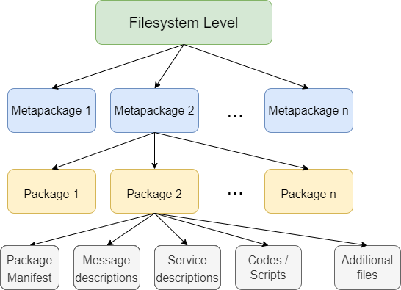
File system level
Optional layer
For more details see:
ROS Wiki

Slide 15
Some „definitions”
Package – Containers of codes/scripts and other supplementary elements for the execution
Metapackage – Packages that are related to each other can be organised into Metapackages.
Manifest file - Containing important information about the package

Slide 16
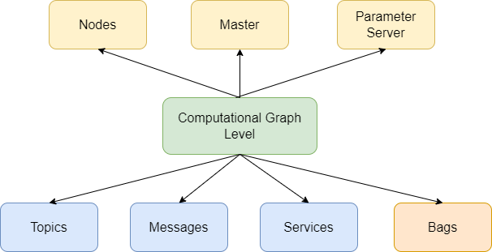
Computation graph level

Slide 17
„Definitions” You will learn on the practicesn
Node
Master
Parameter server
Message/Service
Topics
Bags

Slide 18
Loosely connected parts (Communication between Nodes)
Basic computational units
Communication can be:
Topics (Asynchronous; Unidirectional)
Services (Synchronous; Bi-directional)
Actions (Asynchronous; Bi-directional)
ROS Master is the responsible for the provision of (node)name registration and lookup processes
Establishment of the communication via topics and services [source]

Slide 19
ROS Community Level
Consists of:
Distributions
Repositories
The ROS Wiki
Bug ticket system
Mailing lists
ROS Answers
Blog

Slide 20
How to start? (What to install?)
If You have Windows 11 (or 10):
Install WSL2 (minor performance loss may occure, no communication outside the VM) [1], [2]
Virtual machine (not recommended because of th performance loss, no communication outside the VM) )
Dual boot With Ubuntu 20.04 Focal (highly recommended (only) if You know how to install a dualboot computer)
If You have Ubuntu 20.04 Focal:
Just install ROS2
If You need other option:
https://www.theconstructsim.com/ ← If there is no other possible option (except the virtual machine) then not recommended
Also usage of the lab computers are not recommended (Use Your Laptop … this way You will have Your codes for Yourself)

Slide 21
Usefull literature about ROS
ROS Robot Programming by the TurtleBot3 Developers; ROBOTIS – open source; available here [it is mainly for ROS1]
Francisco Martín Rico - A Concise Introduction to Robot Programming with ROS2 (2022, CRC Press_Chapman & Hall
https://docs.ros.org/en/foxy/index.html
Youtube channels I also recommend:
https://www.youtube.com/@TheConstruct
https://www.youtube.com/@ArticulatedRobotics

Slide 22
Need some ROS1? We’we got You covered!
It is available at:
https://gitlab.com/aidept_mitsz/ros-for-non-robot-specialists
You will need to log in to the following account:
AIDept_student
psw: ELTE_AIDept
You click on Wiki and choose the topic material You need.

